Slide 1
Queen Mary University of London PhD Induction
October 2024

Slide 2
The Research Degrees Office (RDO) is the central administrative office for all students on research programmes: PhD, MD(Res), EngD, DClinDent, ResM. We:
Research Degrees Office
Provide your research student enquiry service
Work with Schools/Institutes to support you throughout your research studies
Organise scholarship payments to funded students
Confirm registration for doctoral student loans to the Student Loans Company
Manage student records, enrolment, annual re-enrolment and issue student ID cards
Manage requests to suspend studies (called interruption of studies), extensions of registration and the examinations process
Advise on the Academic Regulations and Code of Practice for Research Degree Programmes (see https://www.qmul.ac.uk/registry-services/research-degrees/research-student-information/)

Slide 3
Confirmation of student status – look out for your Student Status Letter in your Gradintelligence account (see https://www.qmul.ac.uk/registry-services/student-information/my-studies-/my-documents/gradintelligence-/) Things to check now Enrolment - are you fully enrolled? If you have not yet completed online enrolment please do this as soon as possible (unless you have an approved deferred start date). Please contact pgrenrolment@qmul.ac.uk for advice. EMAIL and MySIS login You should have received your Queen Mary email address and logged into your MySIS account (e.g. for pre-enrolment). Any issues please contact IT Services or use their LiveChat https://www.its.qmul.ac.uk/ Come to see us in RDO or email us about: + student railcard approvals + any questions about your first studentship payment + to collect ID cards
Research Degrees Office

Slide 4
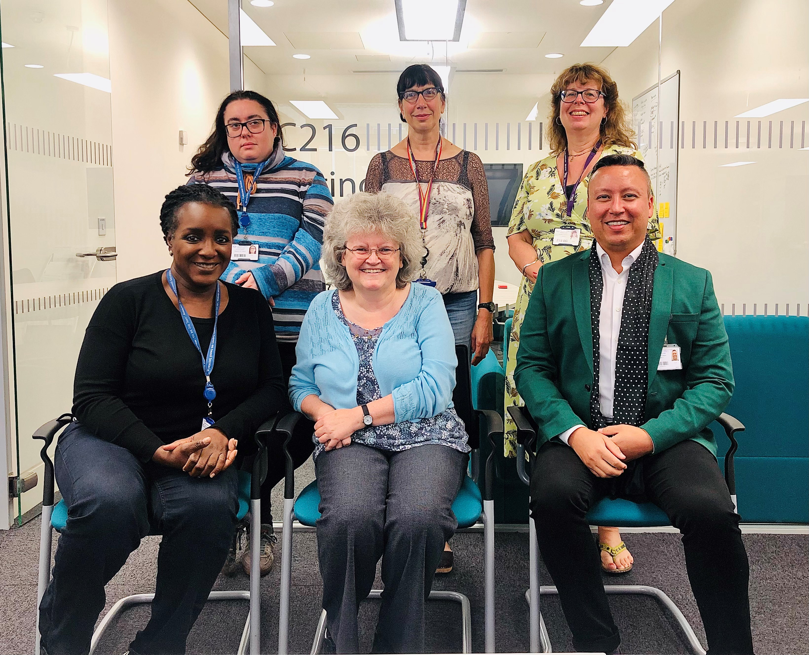
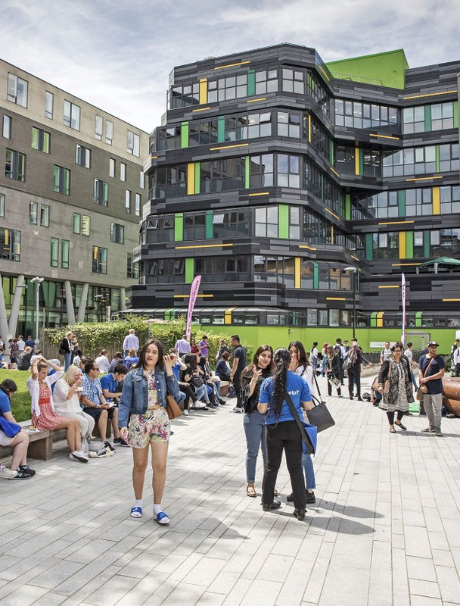
https://www.qmul.ac.uk/registry-services/contact-directory-/research-degrees-office/ Follow the Research Degrees link for contact details and to make an appointment with a member of the team. We wish you every success with your research
Contact details
RDO Office
Graduate Centre, room GC.213, Mile End Campus. Office hours: 10.00 a.m. to 4.00 p.m. Mondays & Wednesday to Friday; Tuesdays 11.00 a.m. to 4.00 p.m.
Email: researchdegrees@qmul.ac.uk

